Slide 1
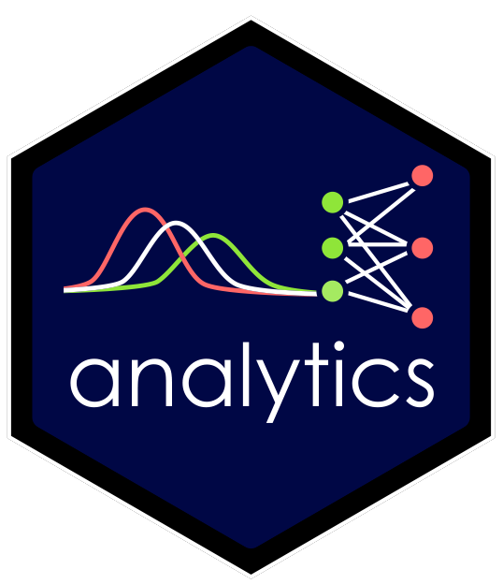
MKTG 411 Marketing Analytics Use data to inform managerial decision-making
Take a deeper dive into analytics beyond Marketing Research and Introductory Business Analytics:
Master programming in R
Focus on marketing applications
Refine analytics workflows
Wrangle and visualize data
Run database and API queries
Produce interactive dashboards
Conduct inferential modeling
Predict with machine learning
Automate reporting
Do project-based coursework
Interact in live, in-person classes
analytics_skill |>
apply() |>
focus() |>
refine() |>
understand() |>
master()

Slide 2
The Theory of Jobs to Be Done
When customers buy a product, they “hire” it to help them do a job:
“What [companies] really need to home in on is the progress that the customer is trying to make in a given circumstance—what the customer hopes to accomplish.”
What if you are the product?
What progress is your customer (a potential employer) trying to make?
Let’s do some market research…
Source: https://hbr.org/2016/09/know-your-customers-jobs-to-be-done

Slide 3

Areas Where Progress Needs to be Made
Goodbye , hello first-party data (Zero Gravity Marketing, MARTECH)
Predictive analytics: anticipate customer behavior and make data-informed decisions before shifts in customer demand
Customer lifetime value prediction
Churn prediction for subscription-based services (e.g., Spotify, Netflix)
Dynamic pricing optimization (e.g., Uber, AirBnB)
Segmentation for personalized marketing campaigns

Slide 4
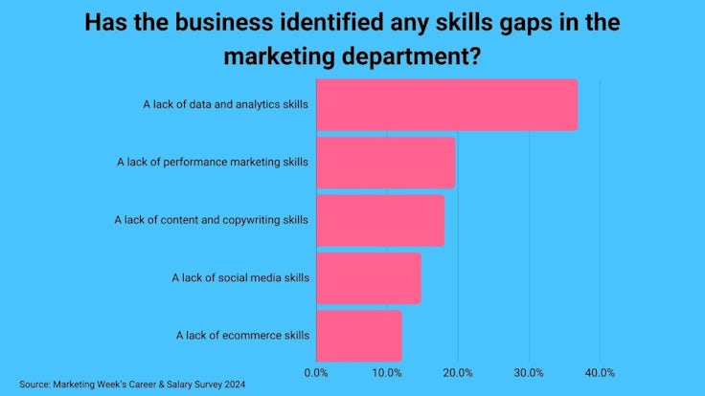
Many Marketers Lack Analytics Skills
Source: https://www.marketingweek.com/marketers-data-analysis-skills-gap/

Slide 5
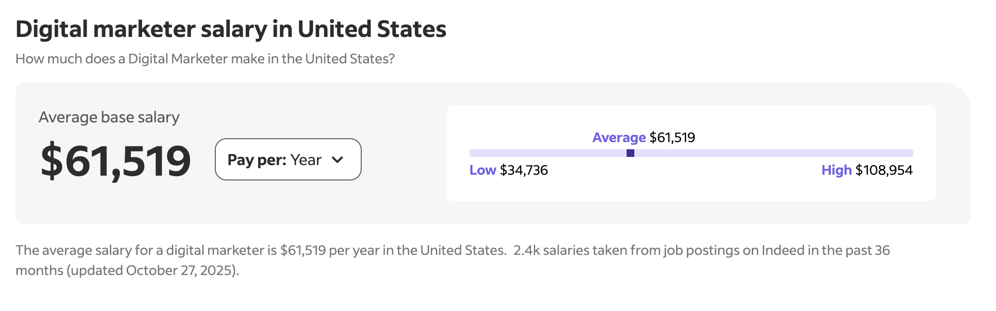
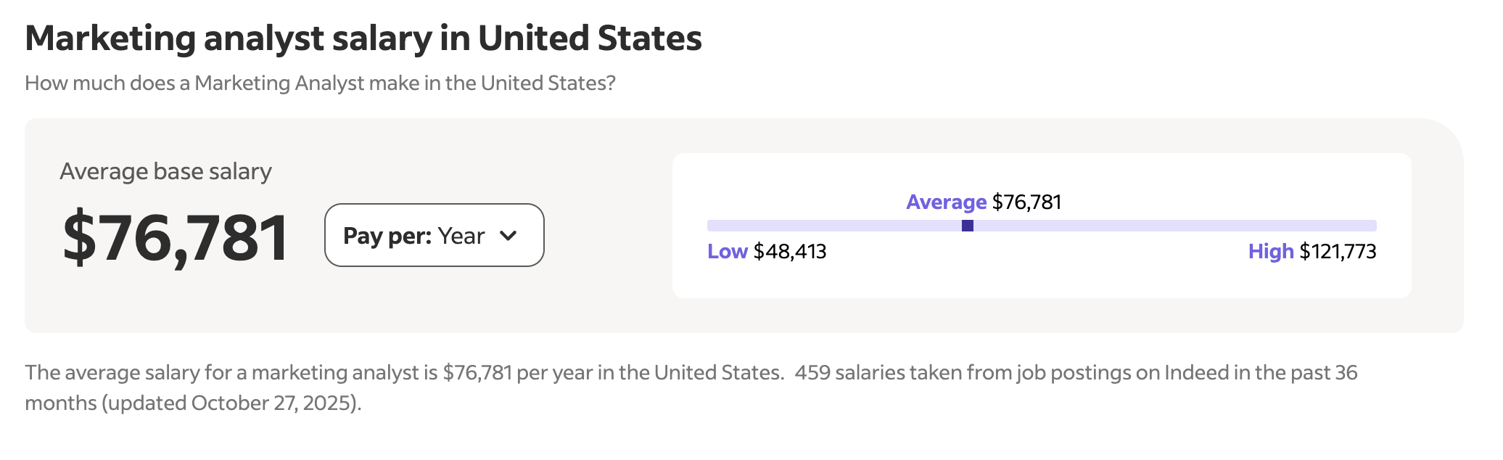
Analytics Skills are Well-Compensated!
Source: Indeed

Slide 6
Make Yourself More Marketable…By Taking MKTG 411!
(And if you’re STILL not bought in…)
In-person class!
I don’t assume experience with programming
What assignments will you be doing? (NO TESTS!)
Exercises (self-graded)
Quizzes (3)
Projects (3)
Questions? cameron.bale@byu.edu

